Slide 1
Advanced Care Plans, Lasting Power of Attorney & RESPECT
Dr Sara Humphrey
GP North Street
GP with a Special Interest in Older People-BTHFT
Associate Clinical Director Frailty & Dementia Bradford District & City CCGs
GP Advisor Yorkshire & Humber Dementia SCN
sara.humphrey@bradford.nhs.uk (Clinical Guidance)
Thursday 16th January 2020

Slide 2
What are we going to cover
What is Advance Care Planning
What it can include
Some demographics
What is legally binding
Advance Decisions to Refuse Treatment
Lasting Power of Attorney
ReSPECT
How to have the conversation
How to find information
Training

Slide 3
What is Advance Care Planning ( ACP)
A discussion in which you may choose to express some views, preferences and wishes about your future care.
  •Explore your options
  •Identify your wishes and preferences
  •Refusing specific treatment, if you wish to
  •Ask someone to speak for you
  •Appoint someone to make decisions for you
        using a lasting power of attorney
      •Let people know your wishes

Slide 4
An ACP may include:
  The person’s concerns
  Their important values or personal goals for care
  Their understanding about their illness & prognosis
  Their preferences for types of care or treatment that maybe beneficial in the future and their understanding of the availability of these ( Advance decisions to refuse treatment)
  Carer emergency care plans
  DNAR
  Emergency Care Plans
  LPA

Slide 5
Emergency Care Plan
ReSPECT
Carers ECP
ECP
Advance Care Plan
Future Wishes
LPA
Lasting Power of Attorney
DNACPR
ADRT
Advance Decision to Refuse Treatment ‘Living Wills’

Slide 6
No. of people with dementia on GP registers in Bradford & Airedale = 5013*
22% of people with Dementia died in 2018—22% of the register
15% with an ACP
ECP
ADRT
1% with Advance Decision to Refuse Treatment
0% with an ECP
42% with carer details recorded
LPA
6% with Lasting Power of Attorney
DNACPR
PPD 20%
35% with DNACPR
* As at 31st Jan 2019

Slide 7
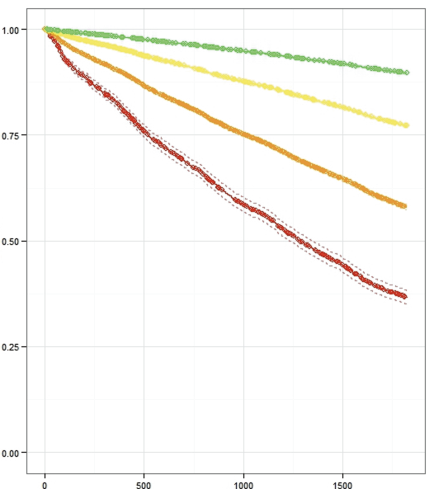
Primary care electronic Frailty Index (eFI): survival plots (n=227,648; >65y)
Supported self-management
Fit
Mild frailty
Moderate frailty
Severe frailty
Care & Support Planning
Proportion alive
Comprehensive Geriatric Assessment
Time
5 yrs
Notes:
The survival plots from each of the frailty states identified by the electronic frailty index would suggest that those with mild or moderate frailty would benefit most from care and support planning and self-management.
It is feasible then that personalised care planning for older people with frailty would have beneficial outcomes. This is the core premise of our Programme.

Slide 8
Advance Care Planning
Advance Statement
Let people know your wishes
Ask someone to speak for you
Named Spokesperson
INFORMAL
Personal
Future Plan
DNAR
ReSPECT
Appoint someone to make decisions
Advance Decision to Refuse Treatment
FORMAL
Legally binding

Slide 9

Refuse treatment in advance
Advance Decision to Refuse Treatment
Advance decision to refuse treatment
Refuses specific treatment in future
Must specify circumstances
Must be written, signed & witnessed, if life sustaining treatment refused
Must state awareness that refusal may shorten life
Advised to discuss with health professionals
Made whilst have capacity
Only comes into force if unable to make wishes known

Slide 10
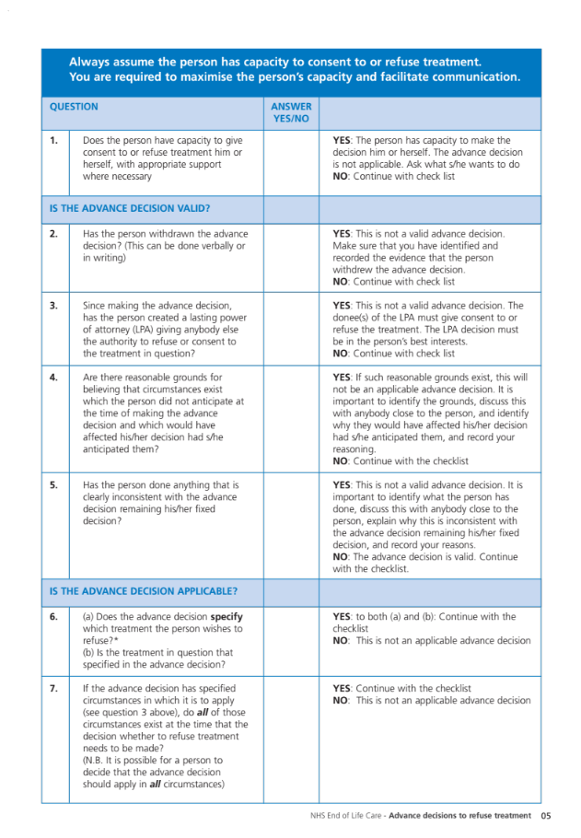
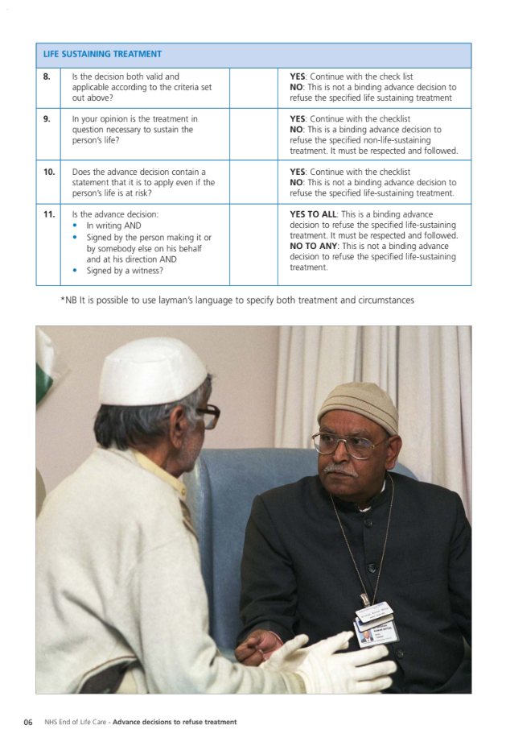
Validity Checklist
National End of Life Care Programme. Advance Decisions to Refuse Treatment: A guide for health and social care professionals..2013 www.endoflifecare.nhs..uk

Slide 11
Appoint someone to make decisions
What is an LPA?
What are the differences between them?
How would you know if someone had one?
Lasting Power of Attorney (for health & welfare)
Legal authority given to another decision maker
  property & affairs
  personal welfare (care & treatment)
Register with Office of Public Guardians
Made whilst have capacity
Only activated if unable to make own decisions
Notes:
Advance Decision to Refuse Treatment
Advance decision to refuse treatment
Refuses specific treatment in future
Must specify circumstances
Must be written, signed & witnessed, if life sustaining treatment refused
Must state awareness that refusal may shorten life
Advised to discuss with health professionals
Made whilst have capacity
Only comes into force if unable to make wishes known

Slide 12
LPA:
Ask to see a copy
Ensure it has been registered
Ensure it covers the Life Sustaining Treatment
Check if there is any ADRT
Check it is registered and no subsequent version with the OPG
https://www.gov.uk/find-someones-attorney-deputy-or-guardian

Slide 13
Solicitors for the Elderly (SFE :
is a national organisation of lawyers such as solicitors, barristers and legal executives, committed to providing and promoting high-quality legal services for older people, their family and carers. Its members must have a set number of years’ experience advising older people and complete an examination before joining as a full or associate member. They must also comply with our Code of Practice, so you can be confident about the service you receive.

Slide 14
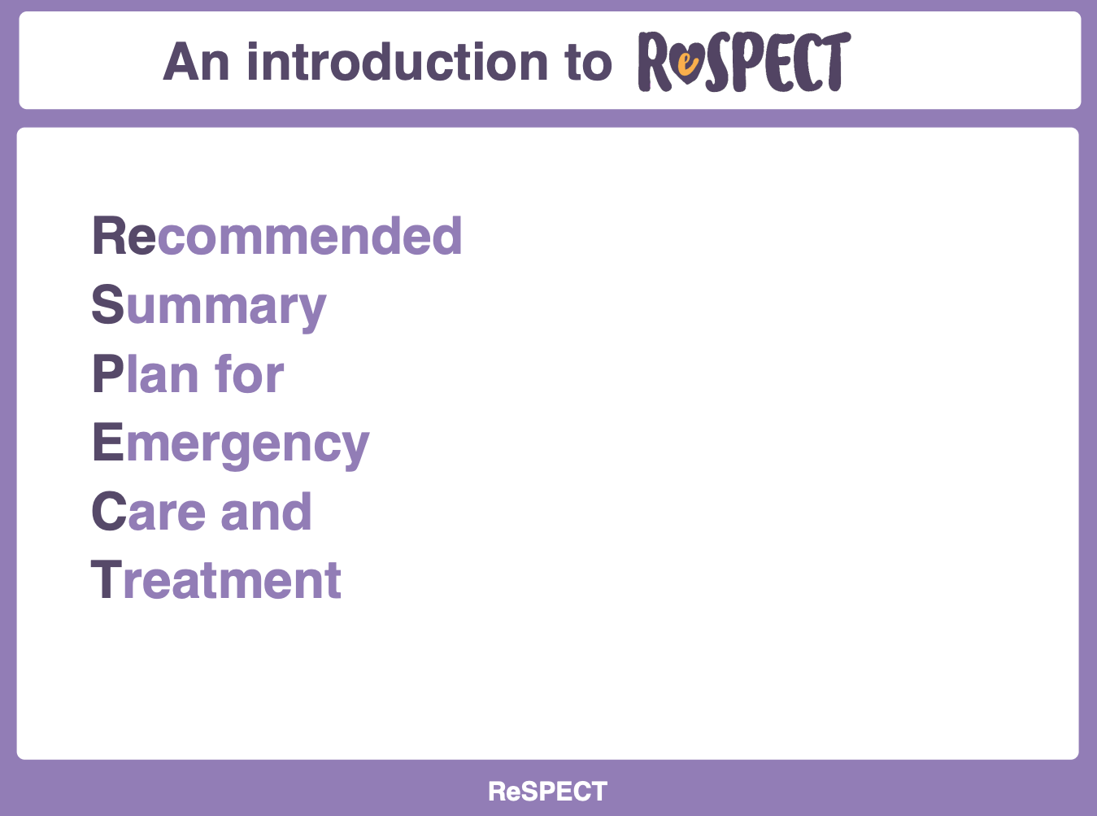
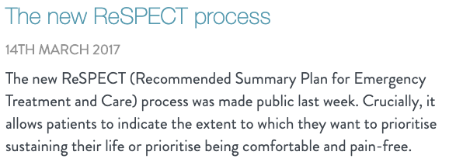

Slide 15
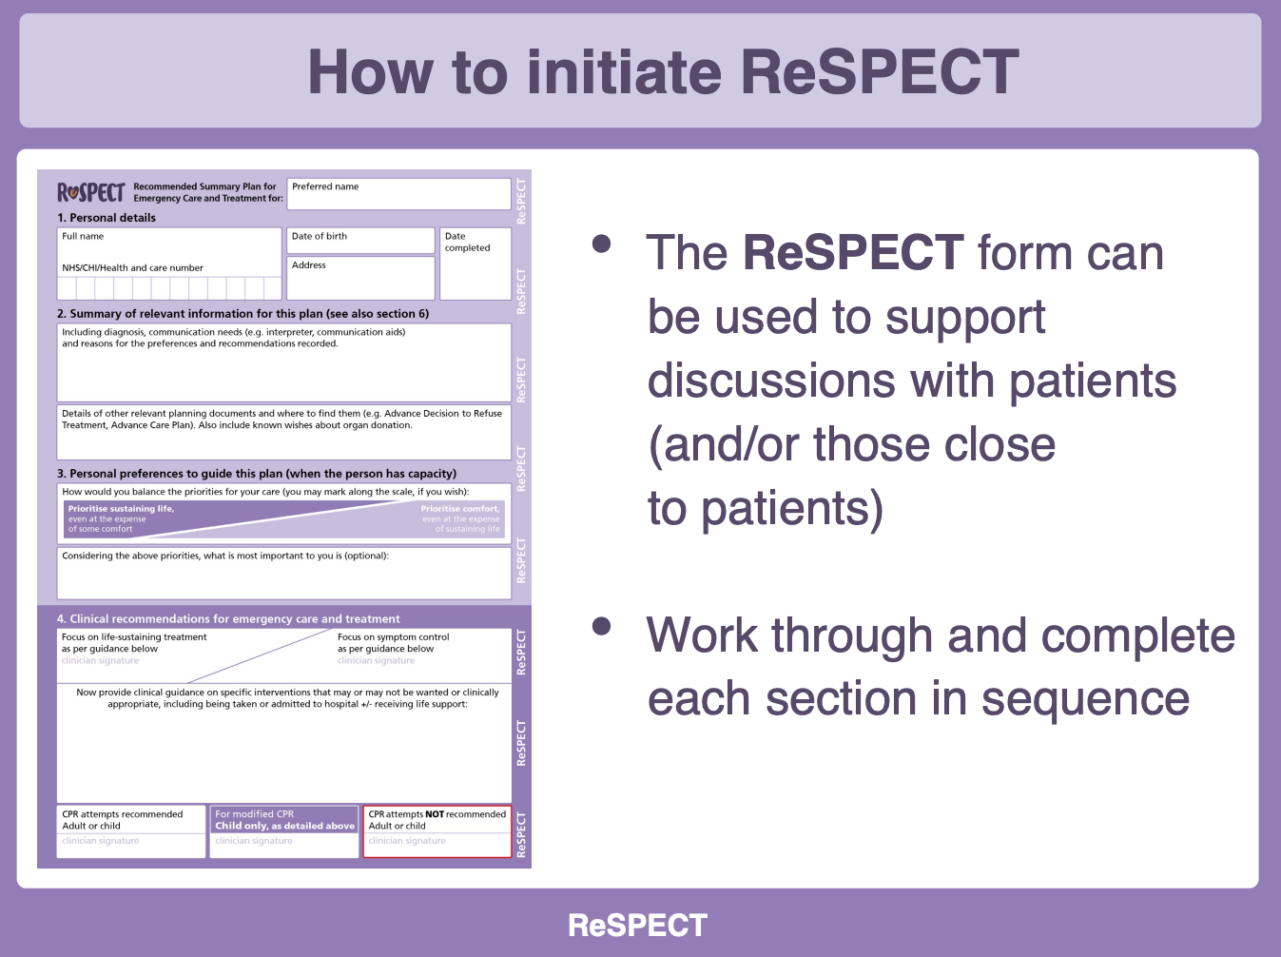

Slide 16
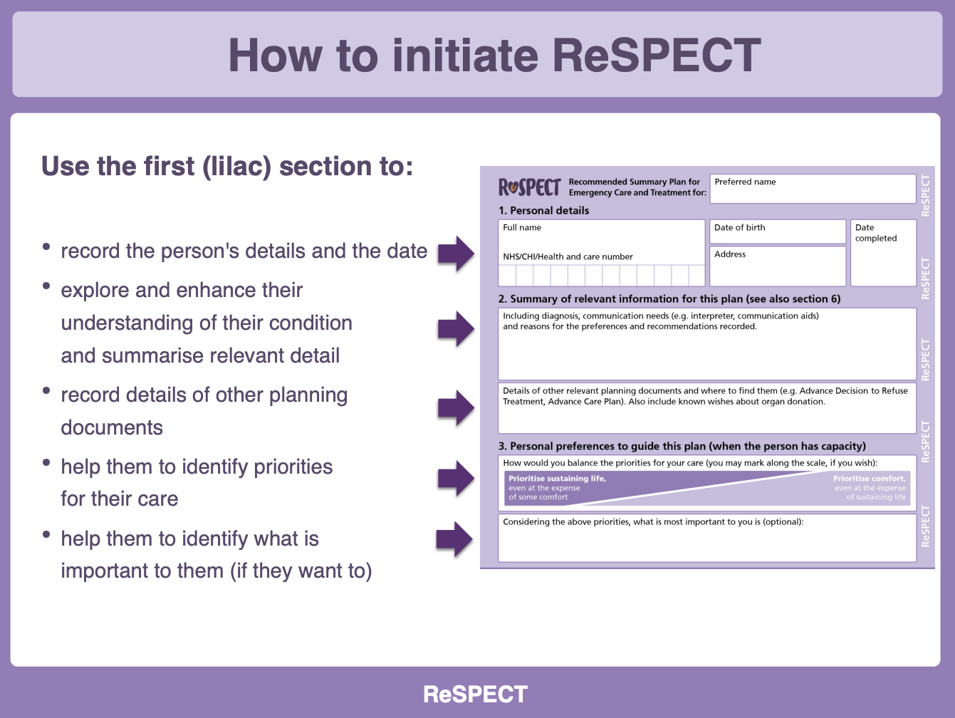

Slide 17
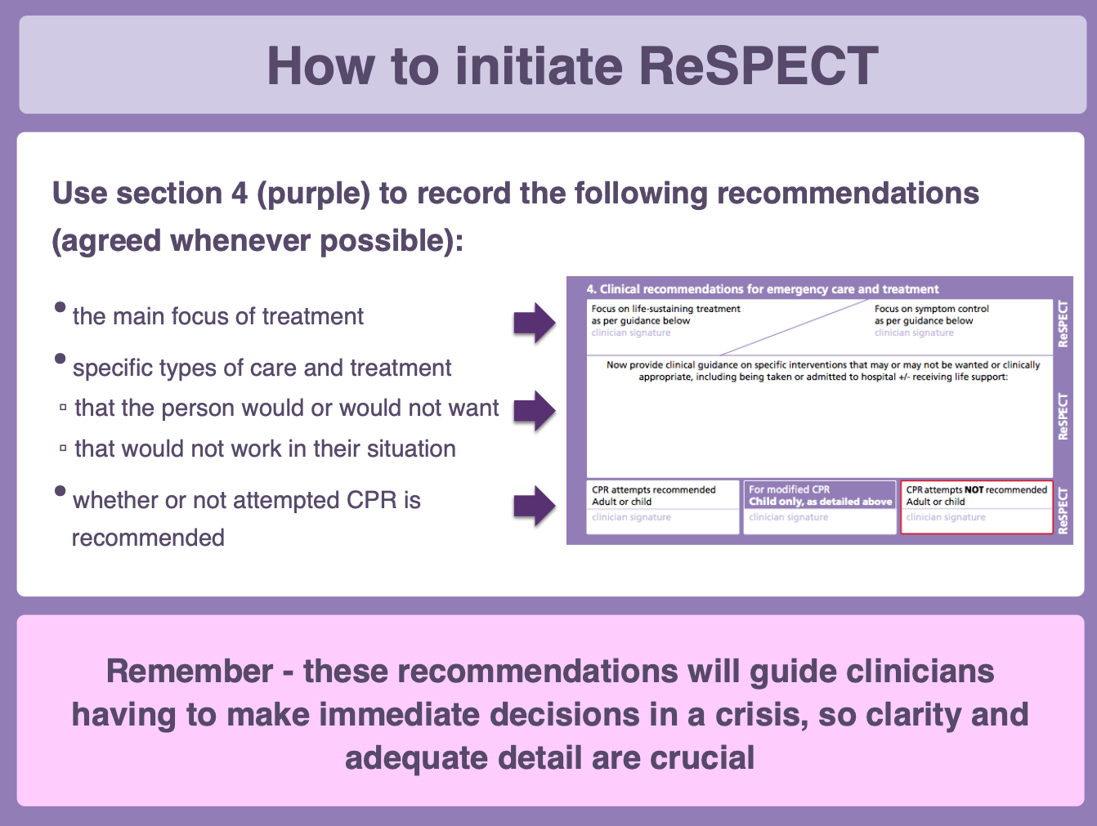

Slide 18
Differences between ECP and ACP
ECPs provide concise, relevant, rapidly accessible clinical recommendations for use in an emergency.
ACPs are more detailed, often completed by the patient, and may focus specifically on end of life care.
The two plans are complementary – they may be developed together or completion of one may prompt consideration of the other.

Slide 19
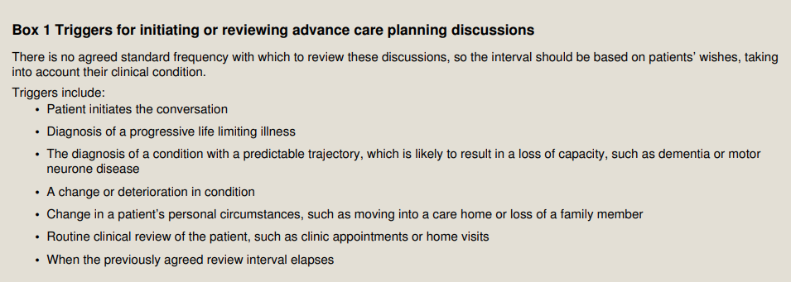
When should we think about Advance Care Planning?
Advance care planning differs from general care planning in that it is usually used in the context of progressive illness and anticipated deterioration.

Slide 20
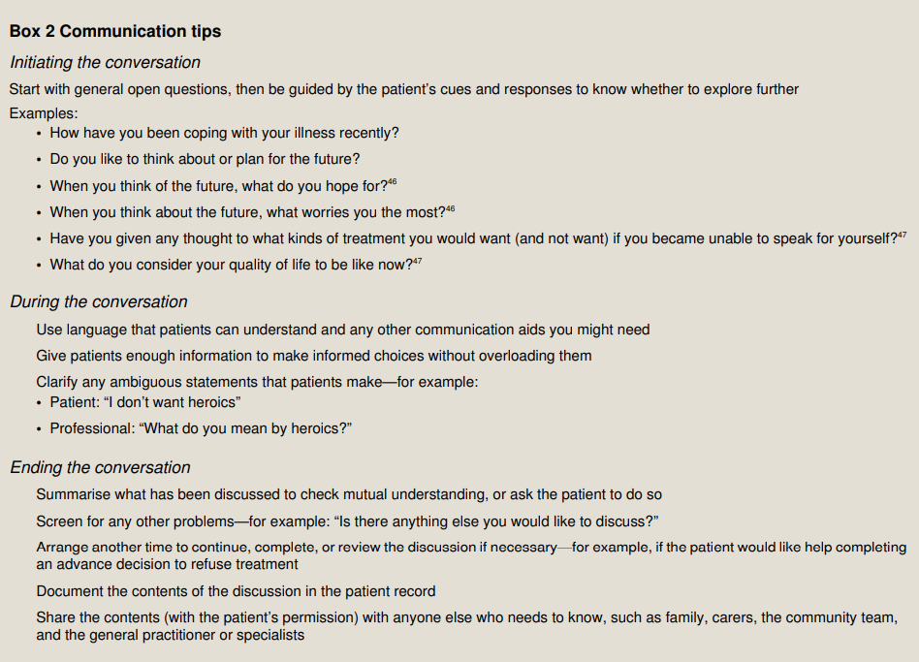
How do you have the conversation?

Slide 21
Who should undertake Advance Care Planning?
Advance care planning is a process of discussion between you and those who provide care for you, for example your nurses, doctors, care home manager or family members and can be undertaken irrespective of discipline
Discussions about refusal of treatment or DNA CPR need to be had with a suitably qualified practitioner & you may need to consider the Mental Capacity of the patient in the discussions
Where patients have severe Dementia and may lack the capacity to make decisions on their own and then it is about ‘Best Interest ‘discussions

Slide 22
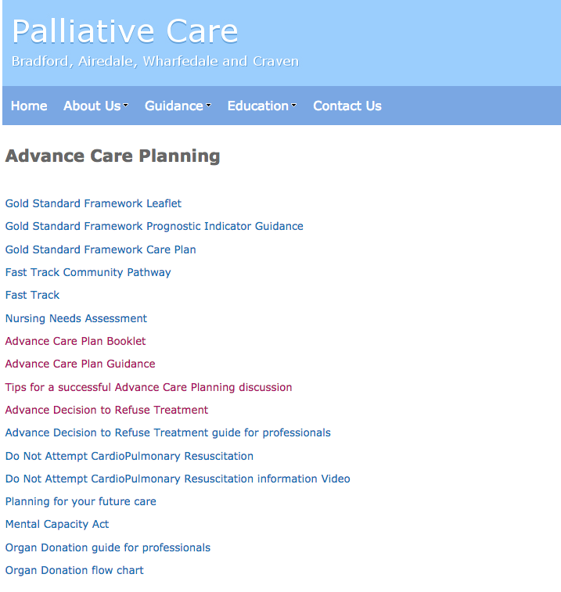
Advance Care Planning in Bradford

Slide 23


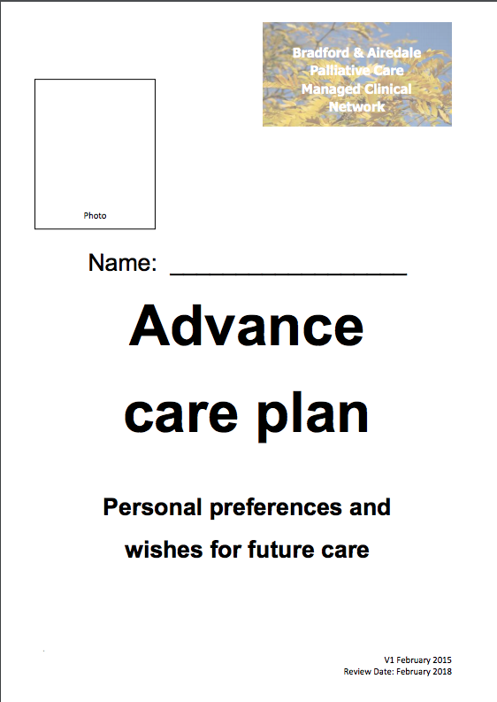
Access to the Bradford Advanced Care Plan document
http://www.palliativecare.bradford.nhs.uk/Documents/Advance%20care%20plan%20booklet.pdf

Slide 24
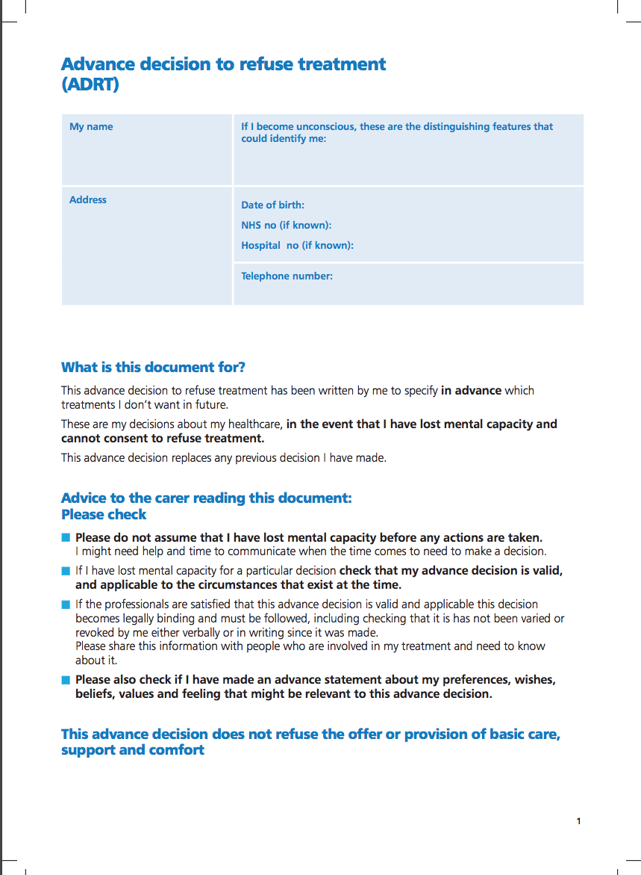

Advance decision to refuse treatment ( ADRT)

Slide 25

Sources of Information for Patients and Professionals
https://compassionindying.org.uk/library/advance-decisions-lasting-powers-of-attorney/

Slide 26
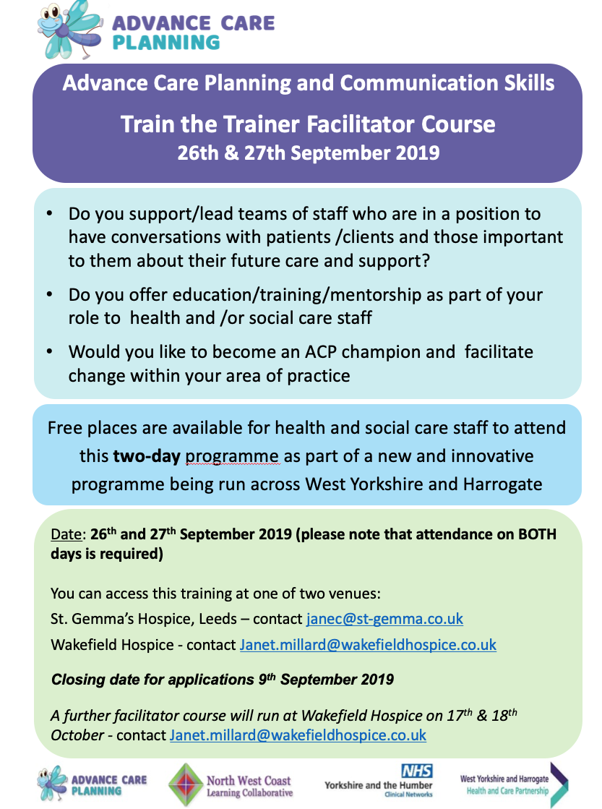
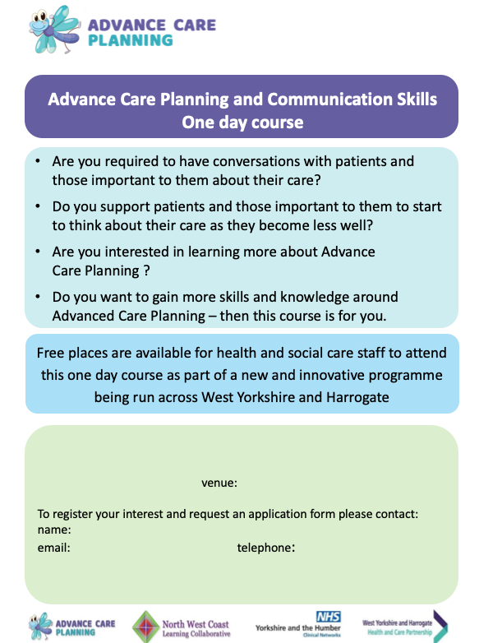
Training

